Slide 1
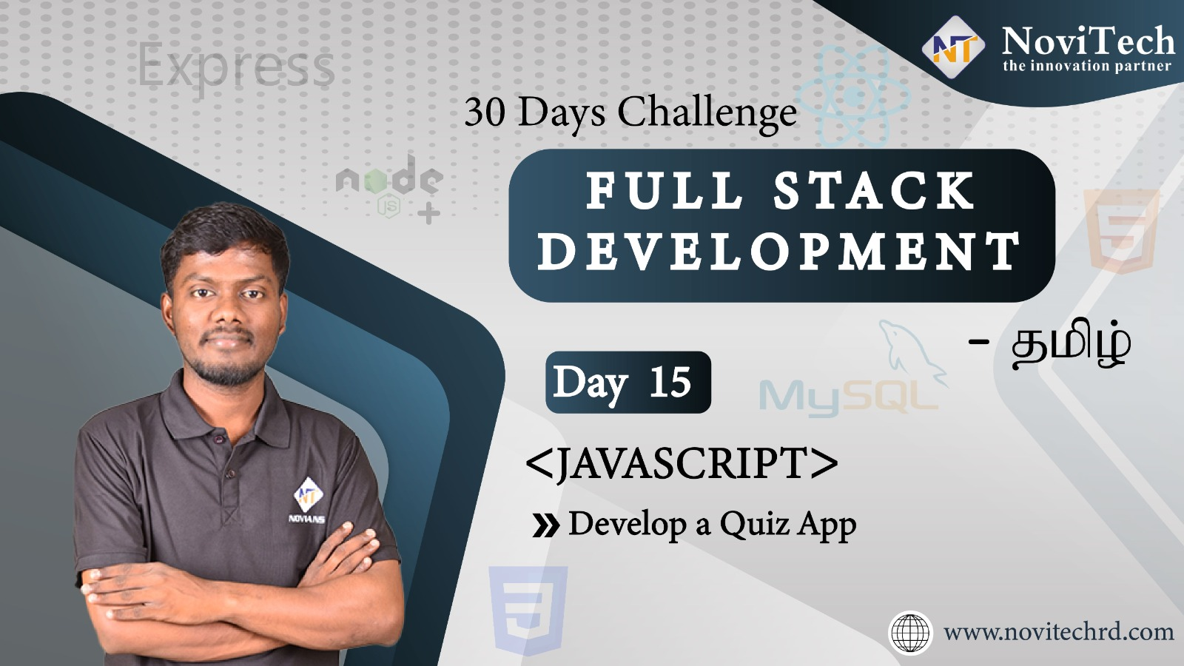

Slide 2

Announcement
ATTENDANCE LINK will be shared in between session
Minimum 28 DAYS Attendance required to receive your
FREE E-CERTIFICATE

Slide 3
Prerequisites
Laptop with Internet Connection
No Prior Knowledge is required
Note & Pen

Slide 4
While Loop
Loops can execute a block of code as long as a specified condition is true.
while (condition) { // code block to be executed }
while (i < 10) { text += "The number is " + i; i++; }

Slide 5
Do-While Loop
The do while loop is a variant of the while loop. This loop will execute the code block once, before checking if the condition is true, then it will repeat the loop as long as the condition is true.
do { // code block to be executed } while (condition);
do { text += "The number is " + i; i++; } while (i < 10);

Slide 6
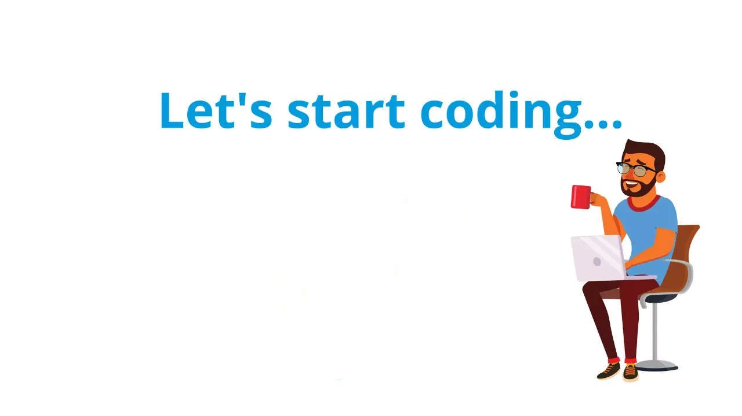

Slide 7



Slide 8



Slide 9
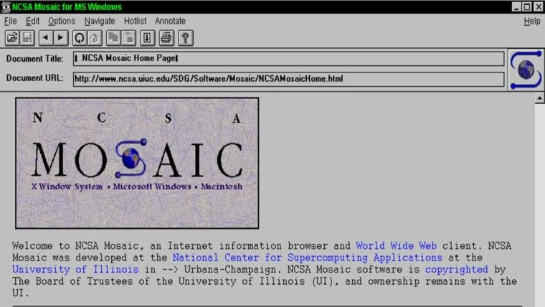
World First Browser

Slide 10



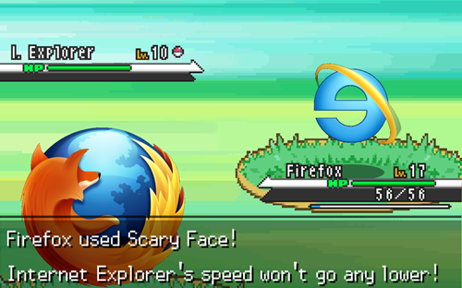

Slide 11

wonder word
CURIOSITY

Slide 12




THANK YOU☺
JOIN WhatsApp community
novitechresearchanddevelopment

Slide 13
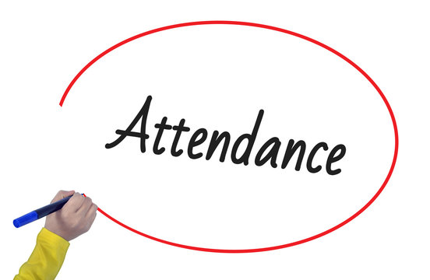
Post Your Attendance

Slide 14


